Slide 1

High Cloud Airlines
Presented by : Group 1
Ayan Basu
Nilofer Asad Ali Sayyad.
A.Shanmuganithya
Mogili venkata yamini Prasanna
Pittam Veenadhari
Megha Parmar

Slide 2
Introduction
High Cloud Airlines operates on a global scale, connecting passengers across continents with a vast network of airlines, cities, and countries. This overview highlights key operational and performance metrics that reflect the company's reach, efficiency, and service strength.
With a strong focus on reliability and customer satisfaction, High Cloud Airlines continues to evolve in a highly dynamic aviation industry. Our mission is to provide seamless travel experiences while maintaining operational excellence across all touchpoints.
As part of the commitment to transparency and growth, we’ve developed an interactive Tableau-based report that captures these performance insights in a clear and visual format. In this presentation, we’ll walk through that report to explore the trends, strengths, and opportunities shaping our journey forward.

Slide 3

KPI-list
Calculate the fields from the Year, Month (#), Day fields.
1
Load Factor percentage on a Carrier Name basis ( Transported passengers / Available seats)
3
Top 10 Carrier Names based passengers preference
4
Top Routes ( from-to City) based on Number of Flights
5
Load factor on Weekend vs Weekdays
6
Number of flights based on Distance group
7
Load Factor percentage on a yearly , Quarterly , Monthly basis ( Transported passengers / Available seats)
2

Slide 4

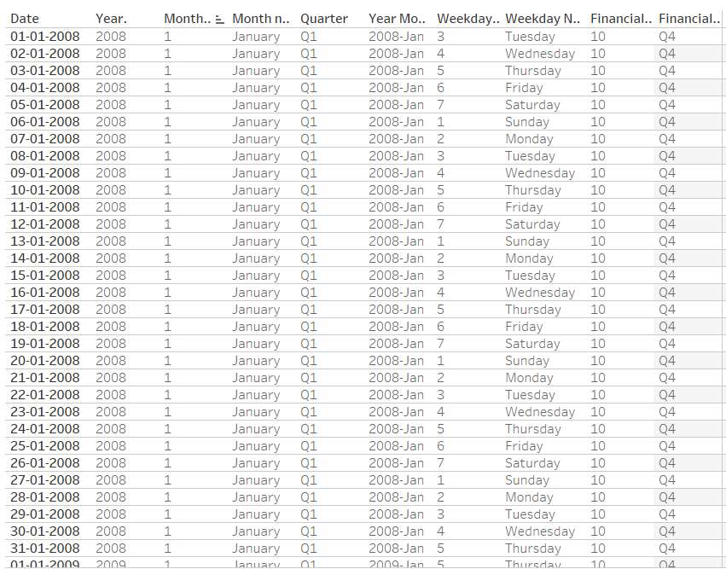
Date Field

Slide 5
Load Factor percentage on a yearly basis
The year-wise analysis of the load factor, which measures the percentage of available seating capacity that is filled by passengers, provides valuable insight into the operational efficiency of High Cloud Airlines.
This metric serves as a key indicator of how well the airline is utilizing its seating capacity. By examining the load factor on a yearly basis, we can better understand shifts in passenger demand, seasonal travel behaviour, and the overall effectiveness of capacity management strategies.

Slide 6
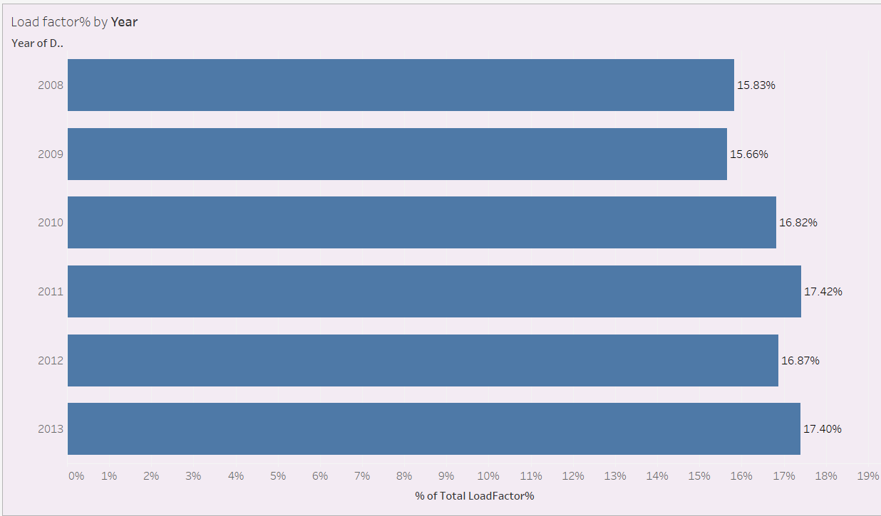
The load factor has shown a generally upward trend over the years, indicating improved aircraft utilization and growing passenger occupancy. Certain years exhibit noticeable peaks in load factor, suggesting periods of strong market demand, optimized route management, or successful seasonal strategies. These trends help in identifying high-performing years and inform planning around capacity, pricing, and seasonal scheduling.

Slide 7
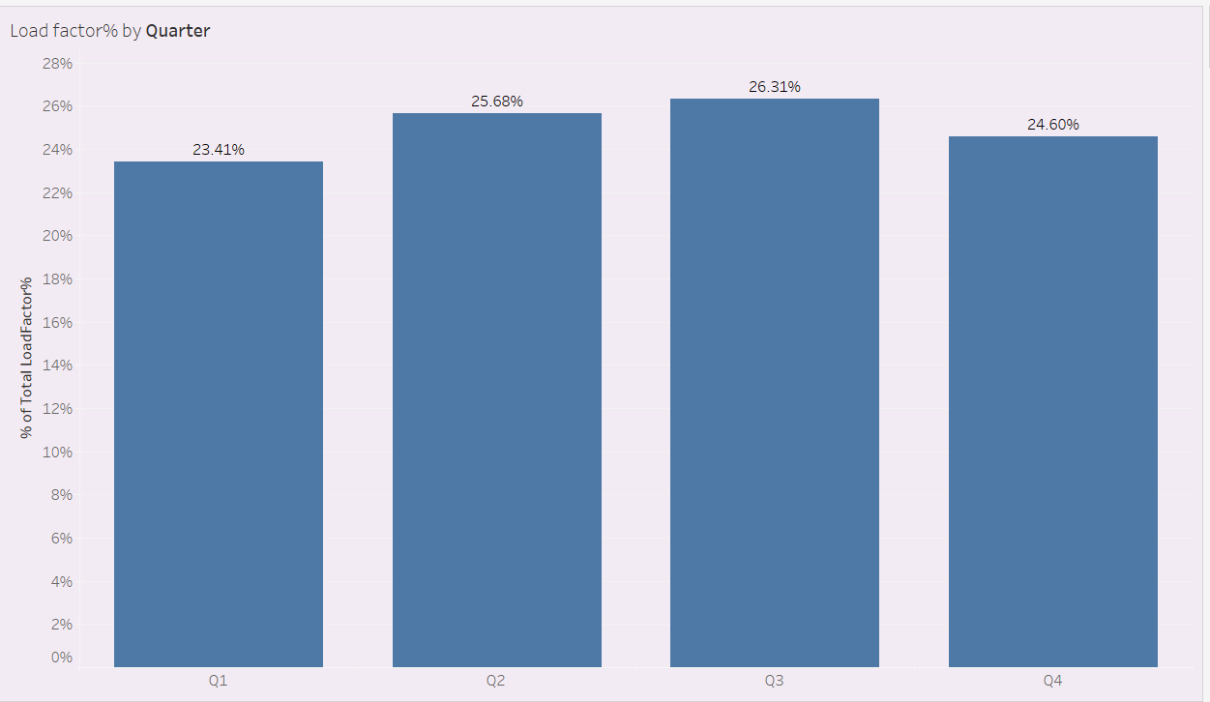
Load Factor percentage on a quarterly basis
Q3 (26.31%) recorded the highest load factor, indicating peak travel during the third quarter due to summer vacation season).
Q2 (25.68%) and Q4 (24.60%) also showed strong performance, reflecting steady travel demand in spring and the holiday season.
Q1 (23.41%) had the lowest load factor, possibly due to post-holiday travel dips and fewer business or leisure trips.
The variation across quarters suggests seasonal travel trends, with Q3 consistently outperforming others.
Airlines can leverage Q3 demand with optimized capacity and pricing strategies to maximize revenue.

Slide 8
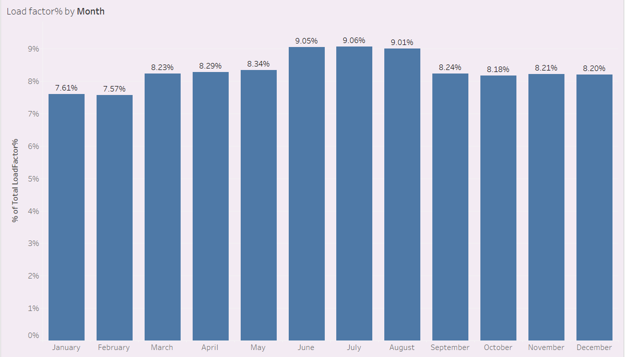
Load Factor percentage on a monthly basis
June (9.05%) and July (9.06%) showed the highest load factors, highlighting peak summer travel. May (8.34%) and August (9.01%) also contributed significantly, supporting the summer trend.
January (7.61%) and February (7.57%) recorded the lowest load factors, likely due to post-holiday slowdowns.
March (8.23%) showed slight recovery with potential spring break travel impact. Load factors gradually increased from March through June, suggesting rising demand through spring into summer.
November (8.21%) and December (8.20%) saw a decline, with December being unexpectedly low despite the holiday season.
Overall, the data reveals strong seasonal patterns with summer months outperforming winter in passenger load efficiency

Slide 9
Load Factor percentage on a carrier name basis
This visualization helps quickly identify which airlines are operating most efficiently in terms of filling available seat capacity.
The chart clearly shows that load factor distribution is heavily leaned toward a few major carriers, indicating market concentration.

Slide 10
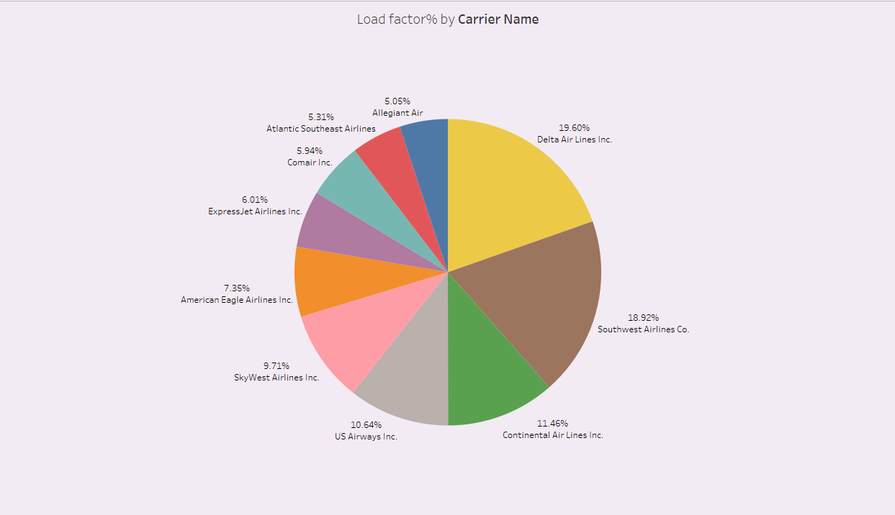
Delta Air Lines Inc. leads with a 19.60% of the total load factor, showcasing its dominance in passenger traffic and operational efficiency.
Southwest Airlines Co. closely follows with 18.92%, reflecting strong demand and a robust point-to-point route model.
AirTran Airways (5.05%) and Atlantic Southeast Airlines (5.31%) show the lowest load factor percentages among the listed carriers.
Together, Delta and Southwest account for nearly 40% of the overall load factor

Slide 11
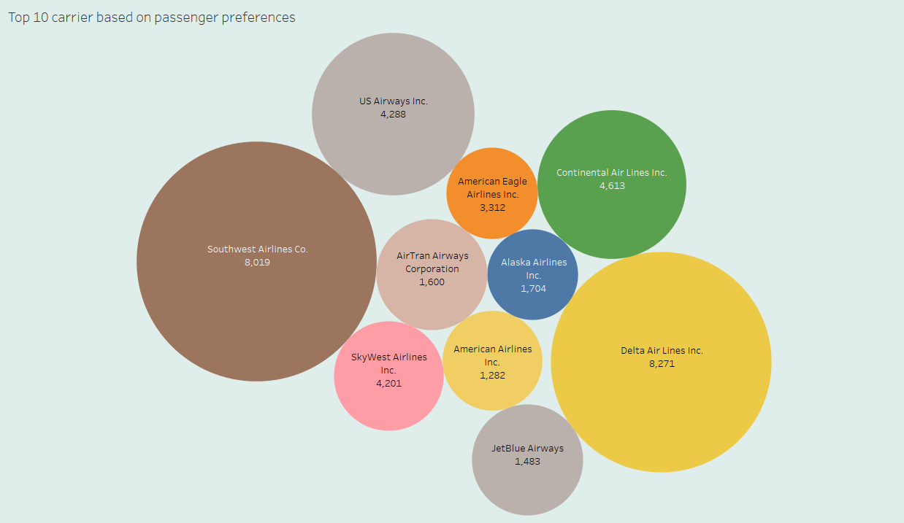
Top 10 Carrier name based on passenger preferences
Delta Air Lines Inc. (8,271 passengers) and Southwest Airlines Co. (8,019 passengers) are the most preferred airlines, indicating strong customer loyalty and brand strength.
Continental Airlines Inc. with 4613 passengers ranks third.
The chart reflects traveller trust, network coverage, and traveller satisfaction, making it a valuable indicator for marketing and service strategy planning.

Slide 12
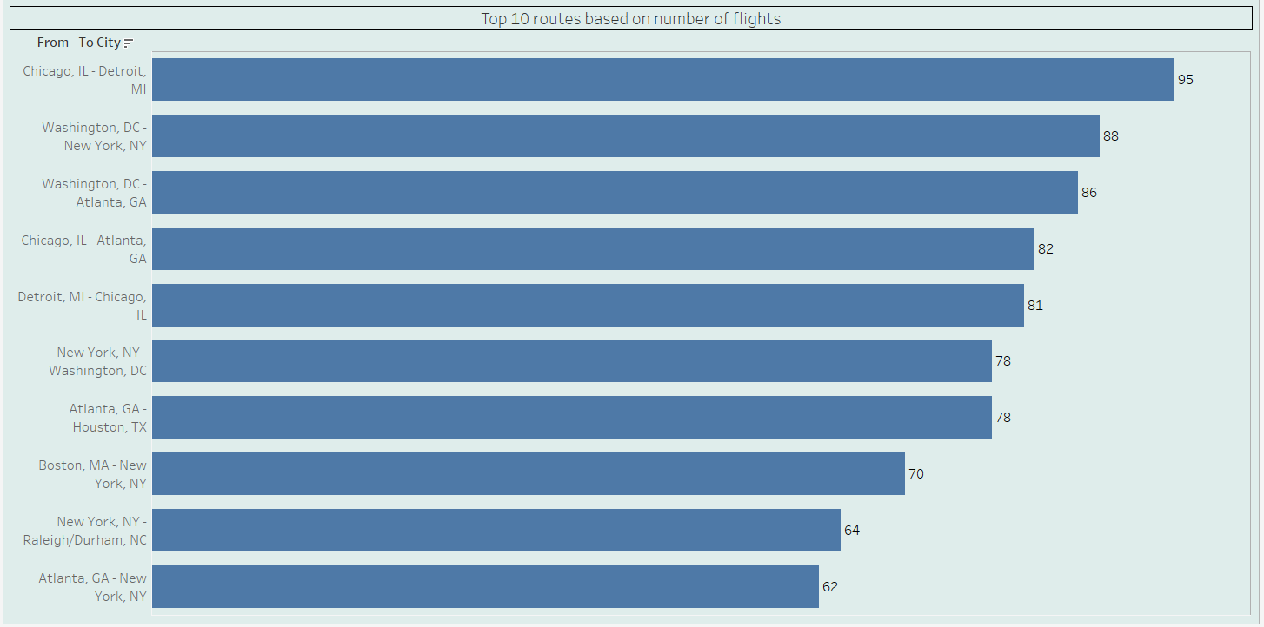
Top Routes ( from-to City) based on Number of Flights
Chicago, IL - Detroit, MI emerges as the busiest route with the 95 flights, indicating strong commuter between these two key cities.
Other high-frequency routes include:
Washington, DC - New York, NY with 88 flights
Washington, DC - Atlanta, GA with 86 flights
Airlines should focus on maximizing efficiency and frequency on these top routes to meet consistent demand and enhance profitability.

Slide 13
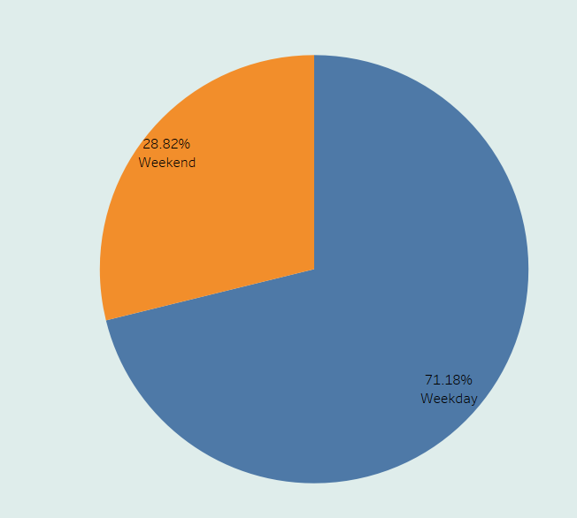
Load factor on Weekend vs Weekdays
Weekdays account for 71.18% of the total load factor, clearly indicating that most air travel occurs during the business week.
Weekends contribute only 28.82%, reflecting lower travel volumes, likely due to reduced business travel and fewer scheduled flights.
The data suggests a strong travel influence, with airlines seeing heavier weekday usage.
Airlines can explore weekend-specific offers or route adjustments to balance load factors and improve weekend utilization.

Slide 14
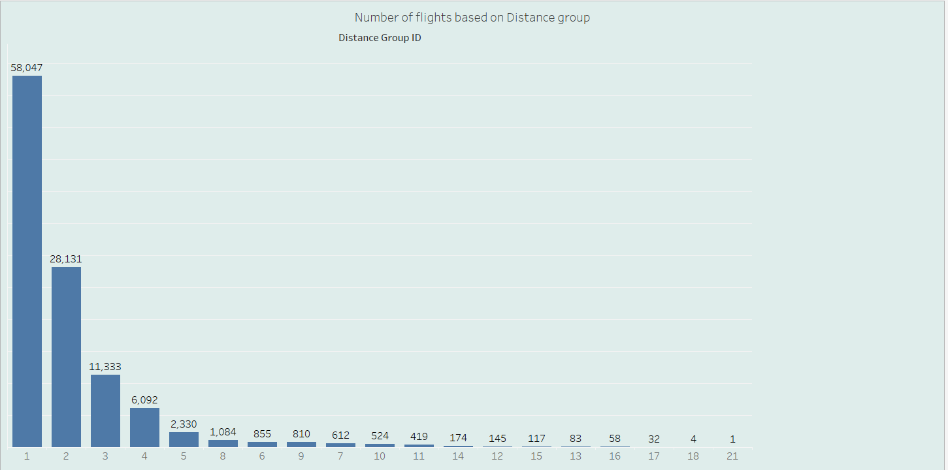
Number of flights based on Distance group
Distance Group 1 has the highest number of flights (58,047), indicating it contains the most frequently operated flights.
The distribution shows that certain distance groups have significantly higher flight volumes.
There is a clear decreasing trend in the number of flights as the Distance Group number increases.
This insight can guide capacity planning and frequency management by identifying which distance groups attract the most flights.

Slide 15
Top Raw KPIs
The dashboard shows that High Cloud Airlines operates across 210 different airlines, reflecting a highly diverse and competitive network.
With operations touching 1,296 cities, the airline clearly maintains an extensive route network.
The airline’s reach across 106 countries confirms its global footprint.
A total of 82.34 million distance have been covered though the airlines during the timeline.
Lastly, with a total of 187.02 million passengers, the airline commands a huge customer base.

Slide 16
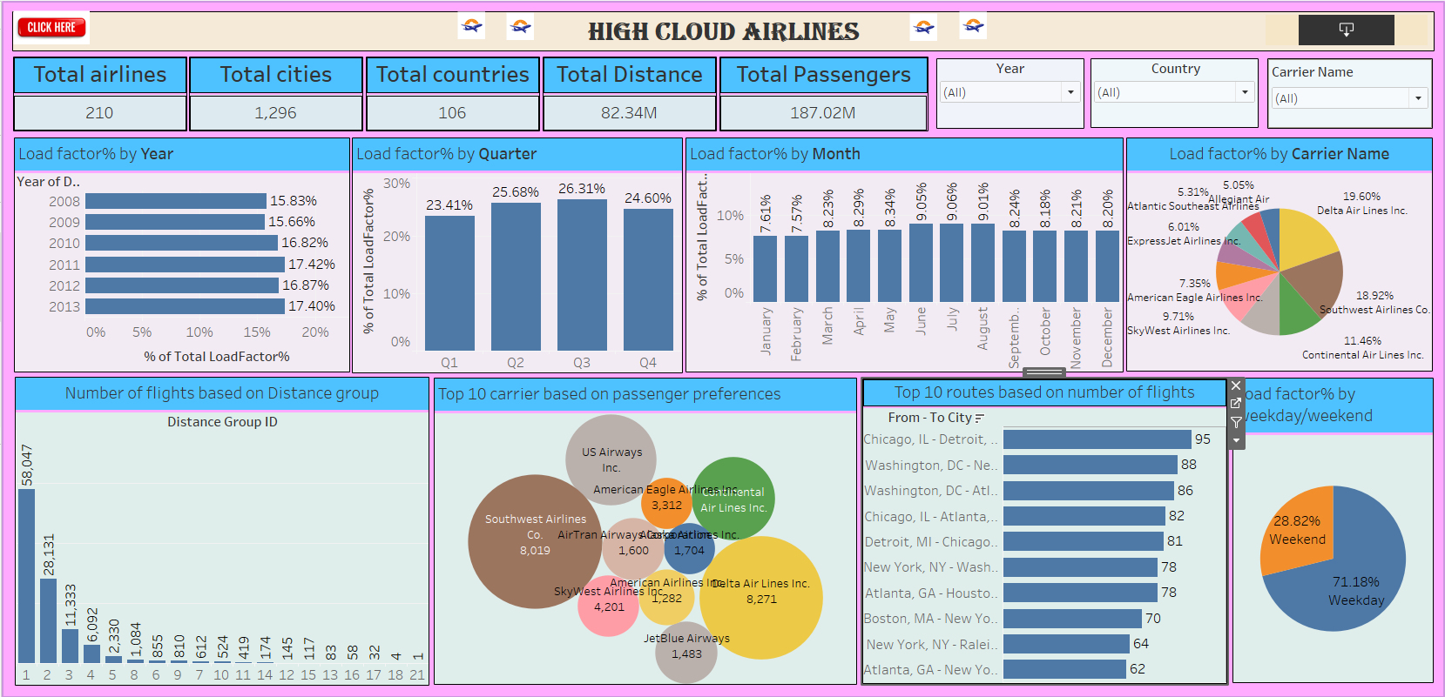
Dashboard

Slide 17
Key Takeaway
High Cloud Airlines has built a broad and busy network, with a strong presence across cities and countries. It’s clear they’re operating at scale, with major carriers leading the charge.
There's a noticeable spike in travel during weekdays and summer months, showing that both business travel and seasonal vacation demand play a big role in how the airline plans its operations.
Certain city pairs—like Chicago to Detroit—stand out as the most travelled, suggesting these routes are essential for both passengers and airline revenue.
Overall, the dashboard shows that High Cloud Airlines is running a tight and well-optimized network, where routes, carriers, and passenger trends are all in sync.

Slide 18

Thank you

